Slide 1
Shifted to Saint Louis, US in May 2017.
Shifted to Tech Mahindra, USA and worked for AT & T project at Saint Louis , Missouri
Dec 2020 : Shifted to new Employer GalaxESystems in and started working on BPM Project for Client Blue Cross Blue Shield of NJ as Contractor.

Slide 2
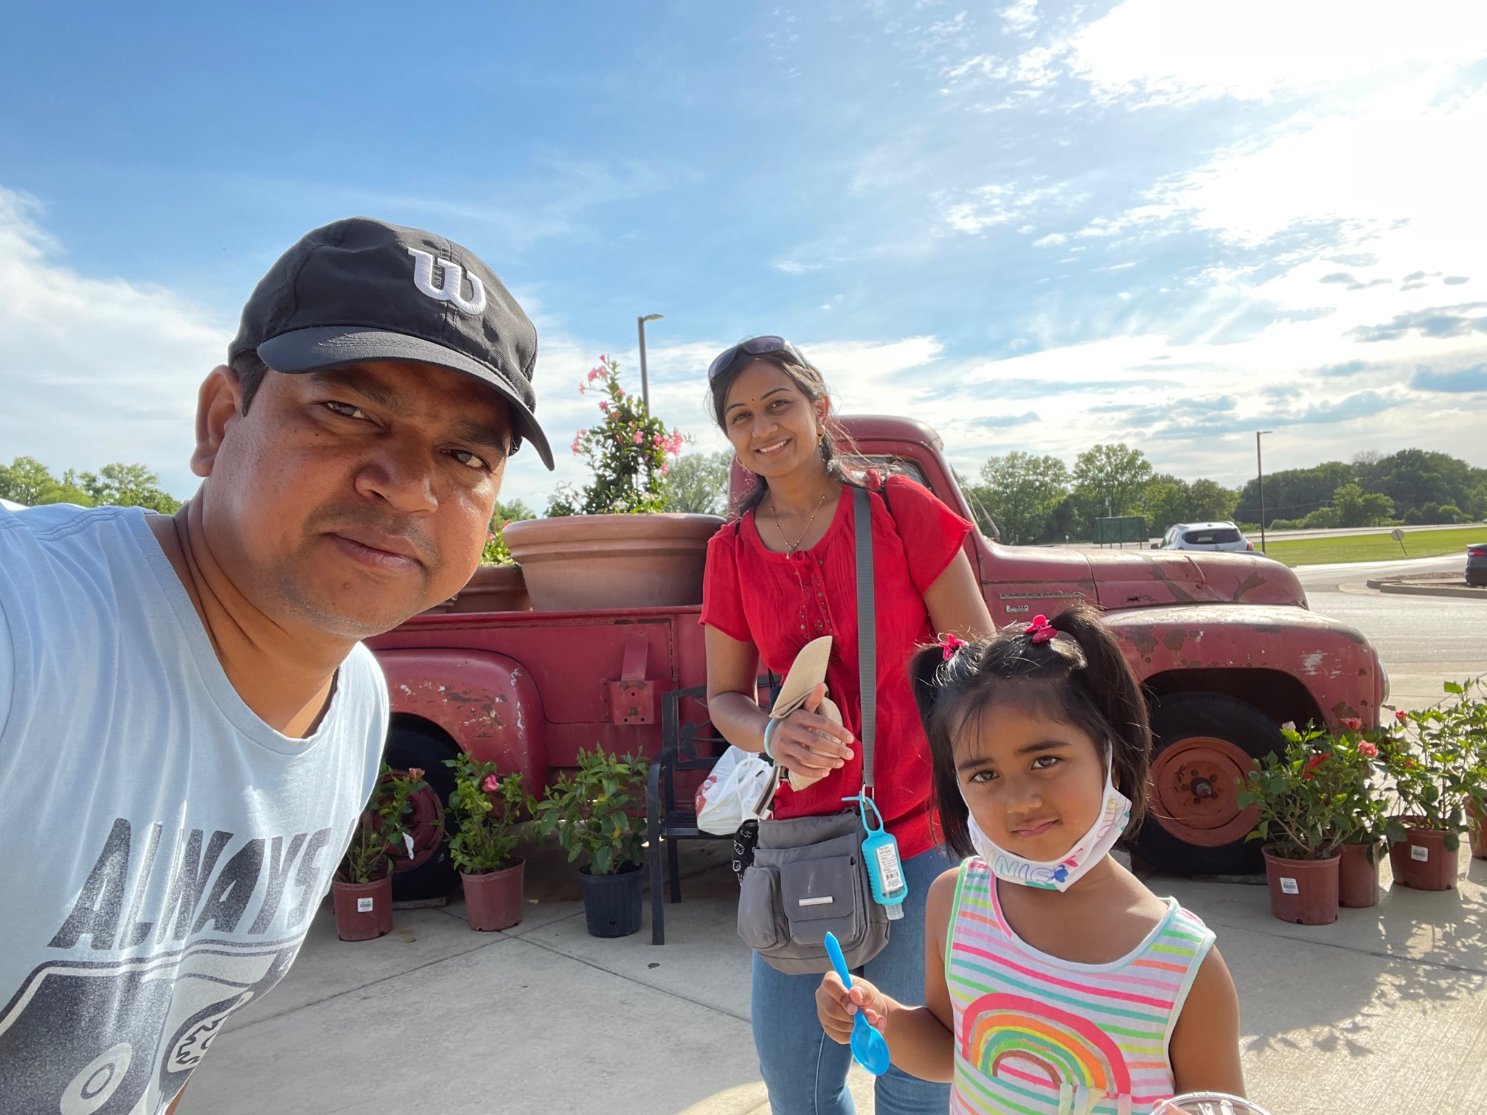
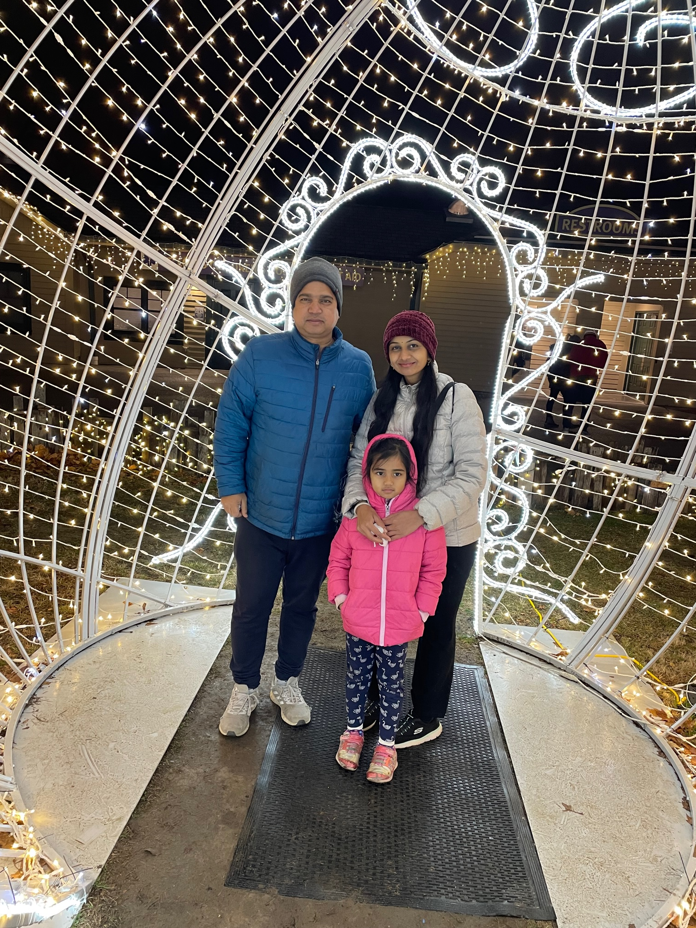
Photos at Saint Louis
Eckert’s farm near Saint Louis
Saint Louis Zoo Winterfest

Slide 3
Shifted to Charlotte, US in Jan 2022.
June 2021 : Shifted to new JBPM Minerva project Wells Fargo Risk Management LOB as Contractor till Feb 2023.
Jan 2022 : Shifted to Charlotte for same project Wells Fargo Risk Management LOB as Contractor till Feb 2023
Apr 2023 : Joined new project at Wells Fargo WIM LOB as Contractor.

Slide 4
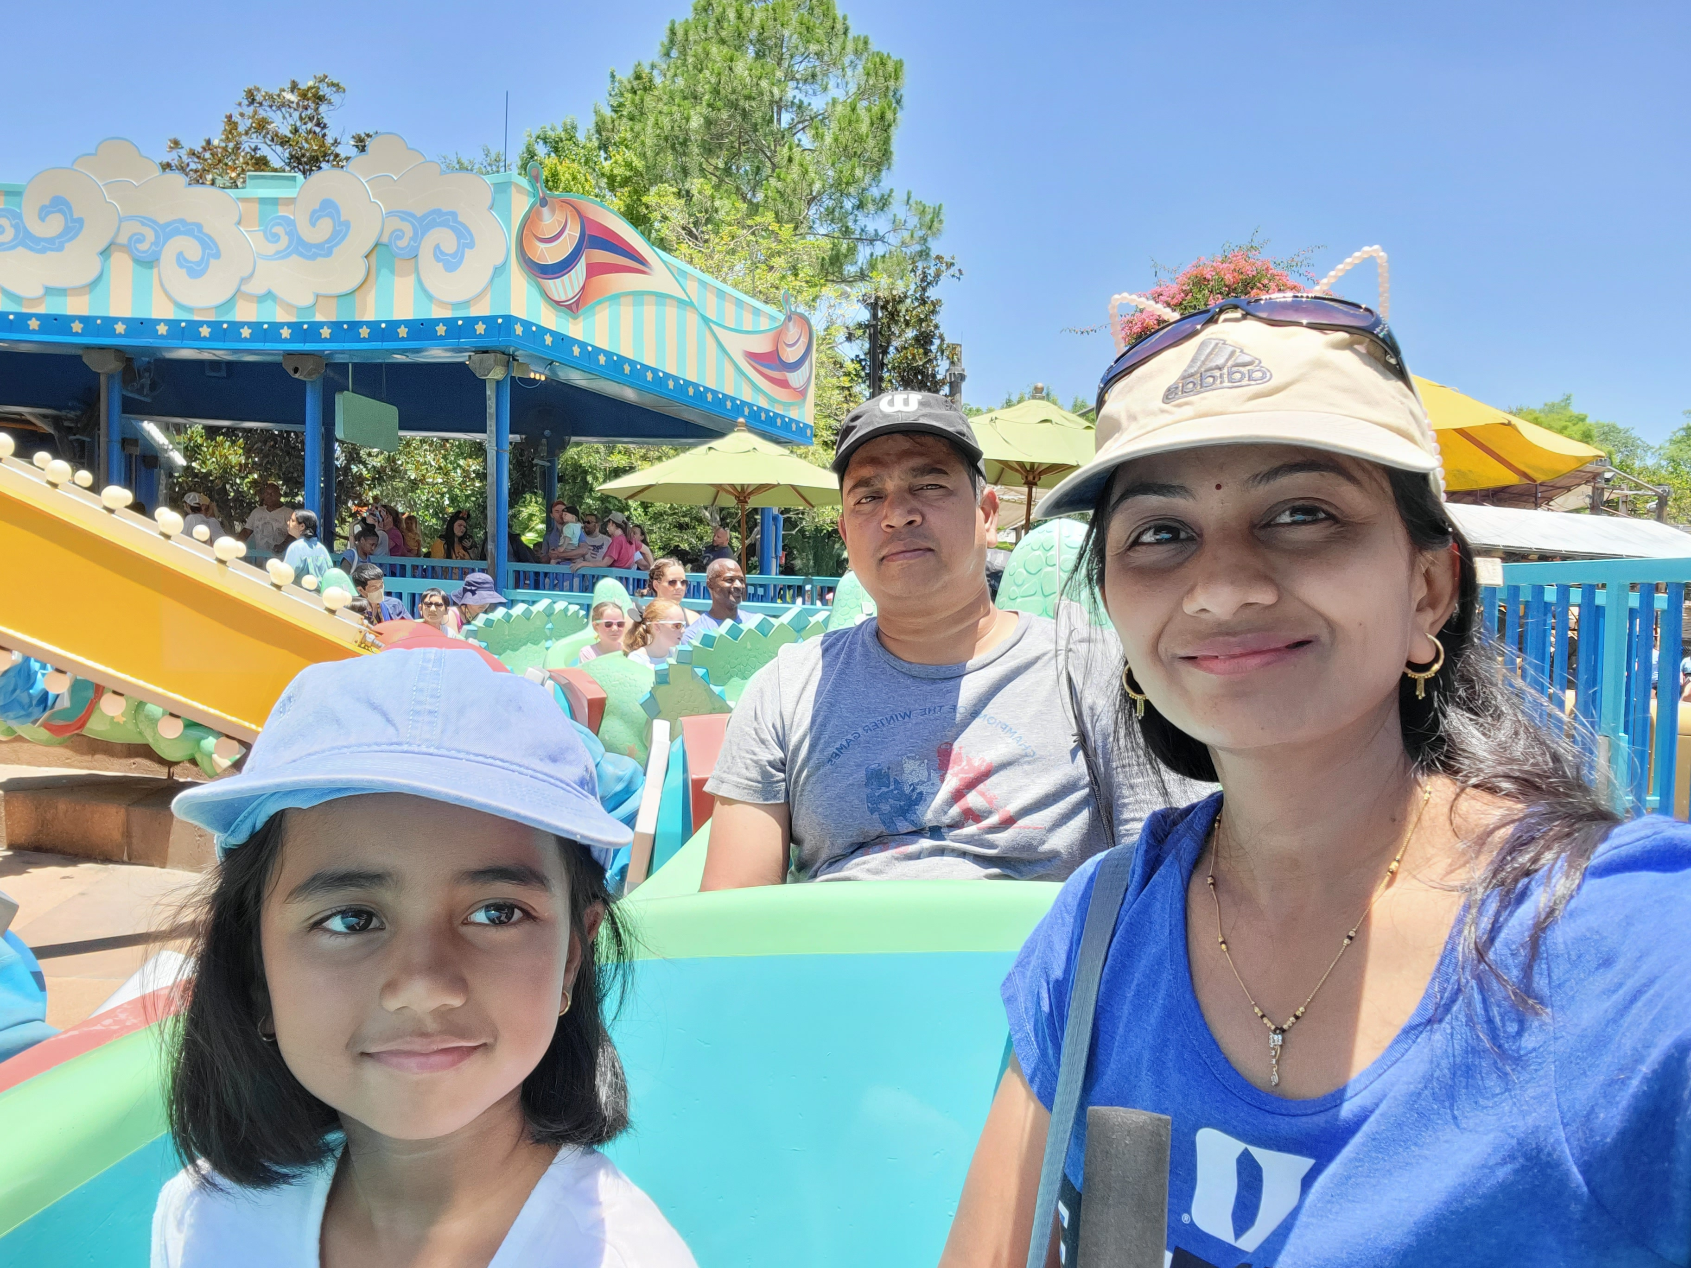
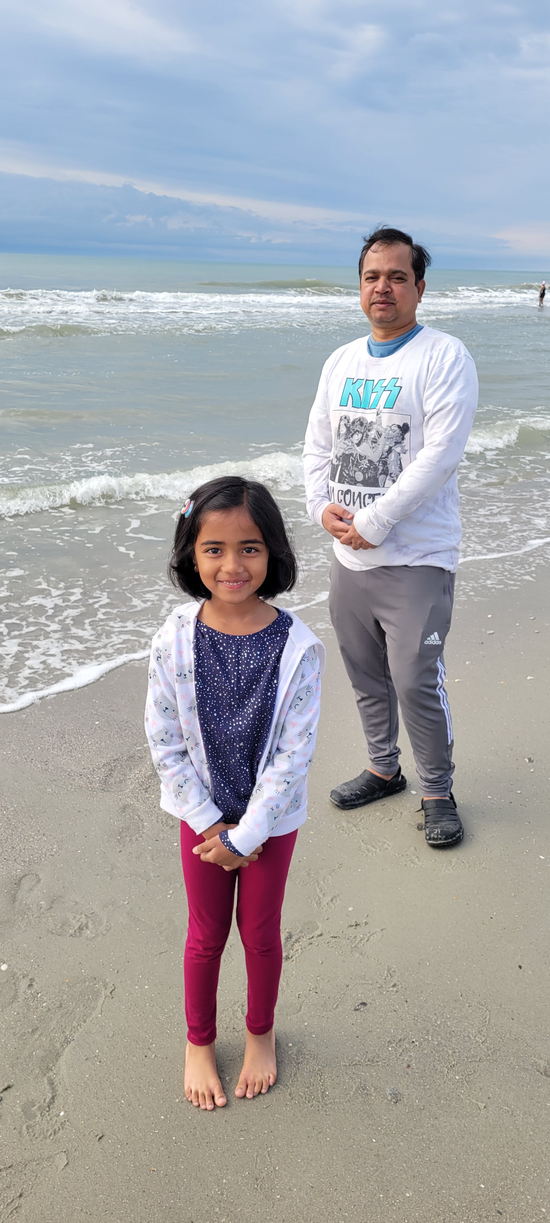
Photos at Charlotte
Disney Tour Last Memorial Day Weekend
Myrtle beach April 2nd week

Slide 5
Hobbies
Playing cricket, tennis, soccer or any outdoor games.
Had my first skating experience at Kate's Skating Rinks last Sunday. Again, going this Sunday.
Reading fiction Novels.
Like to read technical stuff.
Like to learn from Udemy.
Travelling

Slide 6
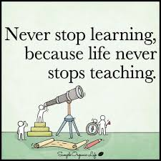
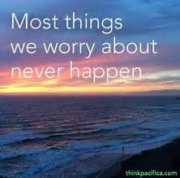

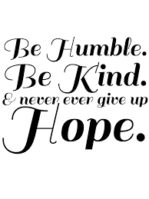
Life Moto

Slide 7
Thank you
Praful Surjuse​
prafuls21@gmail.com
https://www.linkedin.com/in/praful-surjuse-6b42132b/

